Slide 1
7
C Pointers

Slide 2
OBJECTIVES
In this chapter you will learn:
The close relationships among pointers and arrays.

Slide 3
7.8 Pointer Expressions and Pointer Arithmetic
7.9 Relationship between Pointers and Arrays

Slide 4
7.8 Pointer Expressions and Pointer Arithmetic
Arithmetic operations can be performed on pointers
  Increment/decrement pointer (++ or --)
  Add an integer to a pointer( + or += , - or -=)
  Pointers may be subtracted from each other
  Operations meaningless unless performed on an array

Slide 5
7.8 Pointer Expressions and Pointer Arithmetic
5 element int array on machine with 4 byte ints
  vPtr points to first element v[ 0 ]
    at location 3000 (vPtr = 3000)
  vPtr += 2; sets vPtr to 3008
    vPtr points to v[ 2 ] (incremented by 2), but the machine has 4 byte ints, so it points to address 3008

Slide 6
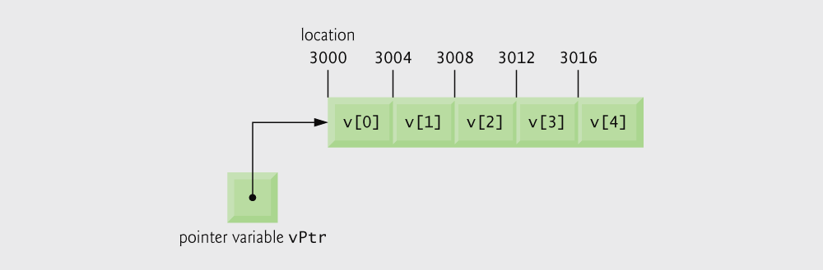
Fig. 7.18 | Array v and a pointer variable vPtr that points to v.

Slide 7
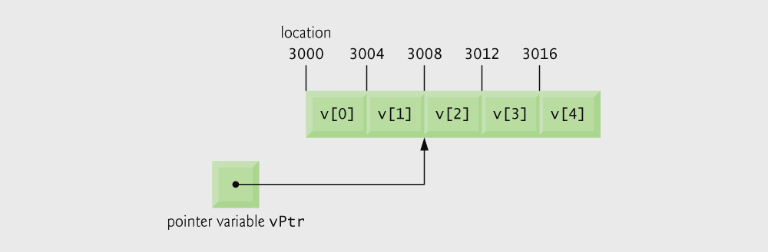
Fig. 7.19 | The pointer vPtr after pointer arithmetic.

Slide 8
Portability Tip 7.3
Most computers today have 2-byte or 4-byte integers. Some of the newer machines use 8-byte integers. Because the results of pointer arithmetic depend on the size of the objects a pointer points to, pointer arithmetic is machine dependent.

Slide 9
7.8 Pointer Expressions and Pointer Arithmetic
Subtracting pointers
  Returns number of elements from one to the other. If
    vPtr2 = v[ 2 ];
    vPtr = v[ 0 ];
  vPtr2 - vPtr would produce 2
Pointer comparison ( <, == , > )
  See which pointer points to the higher numbered array element
  Also, see if a pointer points to 0

Slide 10
Common Programming Error 7.5
Using pointer arithmetic on a pointer that does not refer to an element in an array.

Slide 11
Common Programming Error 7.6
Subtracting or comparing two pointers that do not refer to elements in the same array.

Slide 12
Common Programming Error 7.7
Running off either end of an array when using pointer arithmetic.

Slide 13
7.8 Pointer Expressions and Pointer Arithmetic
Pointers of the same type can be assigned to each other
  If not the same type, a cast operator must be used
  Exception: pointer to void (type void *)
    Generic pointer, represents any type
    No casting needed to convert a pointer to void pointer
    void pointers cannot be dereferenced

Slide 14
Common Programming Error 7.8
Assigning a pointer of one type to a pointer of another type if neither is of type void * is a syntax error.

Slide 15
Common Programming Error 7.9
Dereferencing a void * pointer is a syntax error.

Slide 16
7.9 Relationship Between Pointers and Arrays
Arrays and pointers closely related
  Array name like a constant pointer
  Pointers can do array subscripting operations
Define an array b[ 5 ] and a pointer bPtr
  To set them equal to one another use:
      bPtr = b;
    The array name (b) is actually the address of first element of the array b[ 5 ]
      bPtr = &b[ 0 ]
    Explicitly assigns bPtr to address of first element of b

Slide 17
7.9 Relationship Between Pointers and Arrays
  Element b[ 3 ]
    Can be accessed by *( bPtr + 3 )
      Where 3 is called the offset. Called pointer/offset notation
    Can be accessed by bptr[ 3 ]
      Called pointer/subscript notation
      bPtr[ 3 ] same as b[ 3 ]
    Can be accessed by performing pointer arithmetic on the array itself
      *( b + 3 )

Slide 18
Common Programming Error 7.10
Attempting to modify an array name with pointer arithmetic is a syntax error.

Slide 19
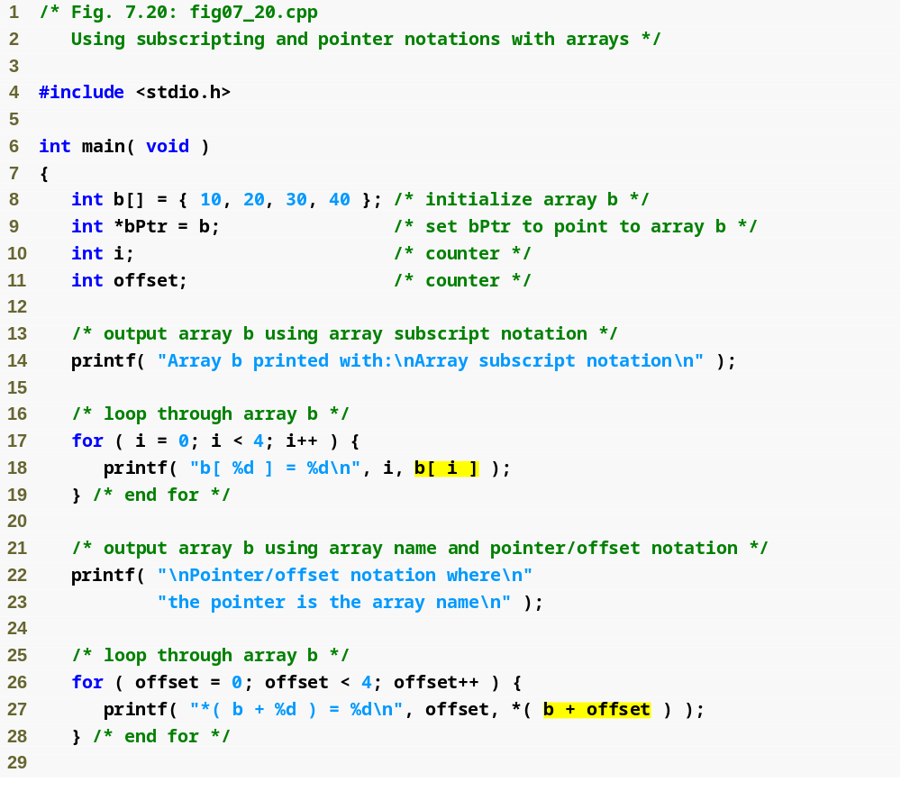
Outline
fig07_20.c
(1 of 3 )
Array subscript notation
Pointer/offset notation

Slide 20
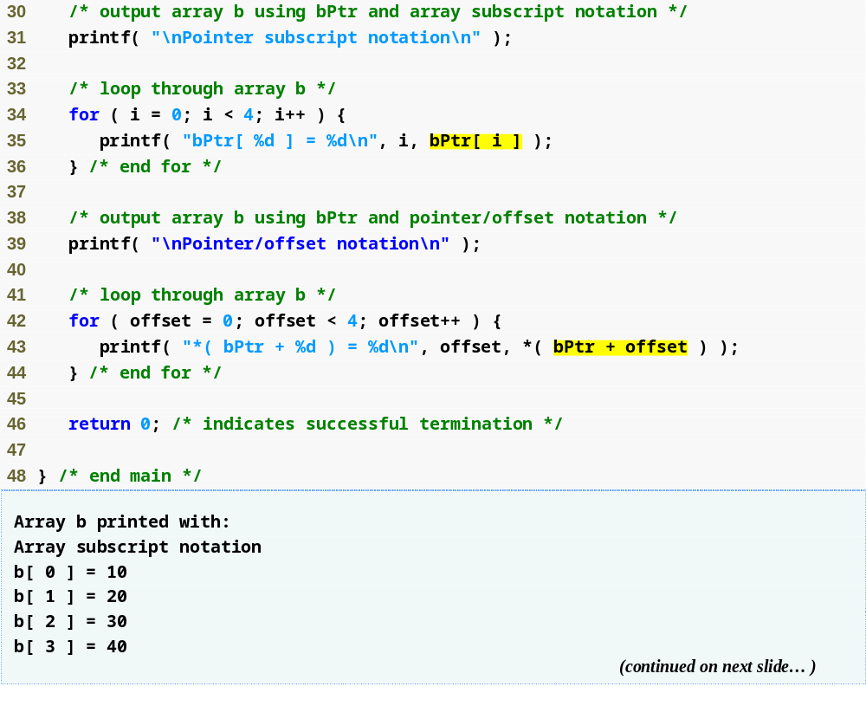
Outline
Pointer subscript notation
fig07_20.c
(2 of 3 )
Pointer offset notation

Slide 21
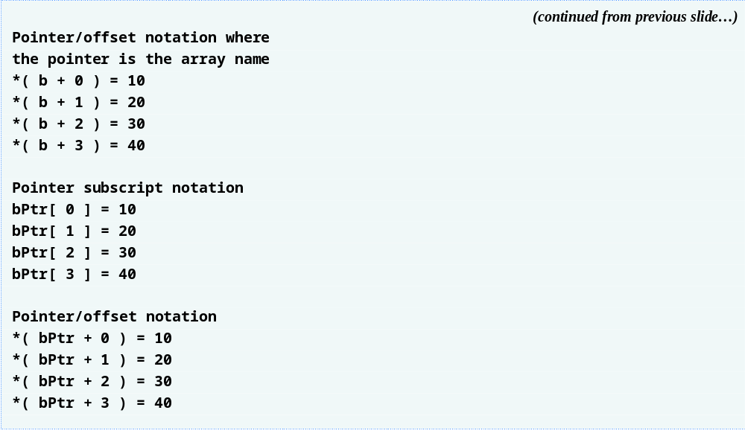
Outline
fig07_20.c
(3 of 3 )

